Slide 1
SMART SECURITY SYSTEM FOR HOMES

Slide 2
AIM
Motion or Intrusion detection
Flame detection
Capture video of the detected person or object

Slide 3
HARDWARE USED
Raspberry Pi 3 Model B
Basic Shield
Bread Board
IR Proximity Sensor
Buzzer
Flame Sensor ( HL 01 )
Logitech USB Camera
Jumper Cables (Male to female, Female to female)
LAN Cable
USB mini cable

Slide 4
SOFTWARE USED
Python IDE
MIT App Inventor

Slide 5
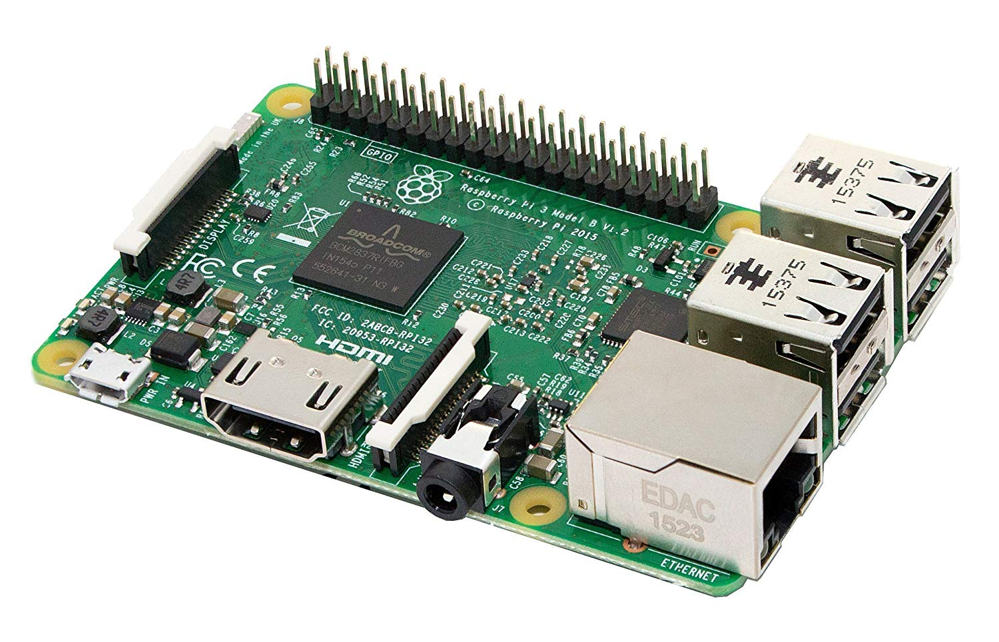
RASPBERRY PI
The Raspberry Pi 3 Model B is a tiny credit card sized computer.

Slide 6

BUZZER
A buzzer or a beeper is an audio signaling device.
Typical user of buzzer includes alarm devices , timers etc.

Slide 7
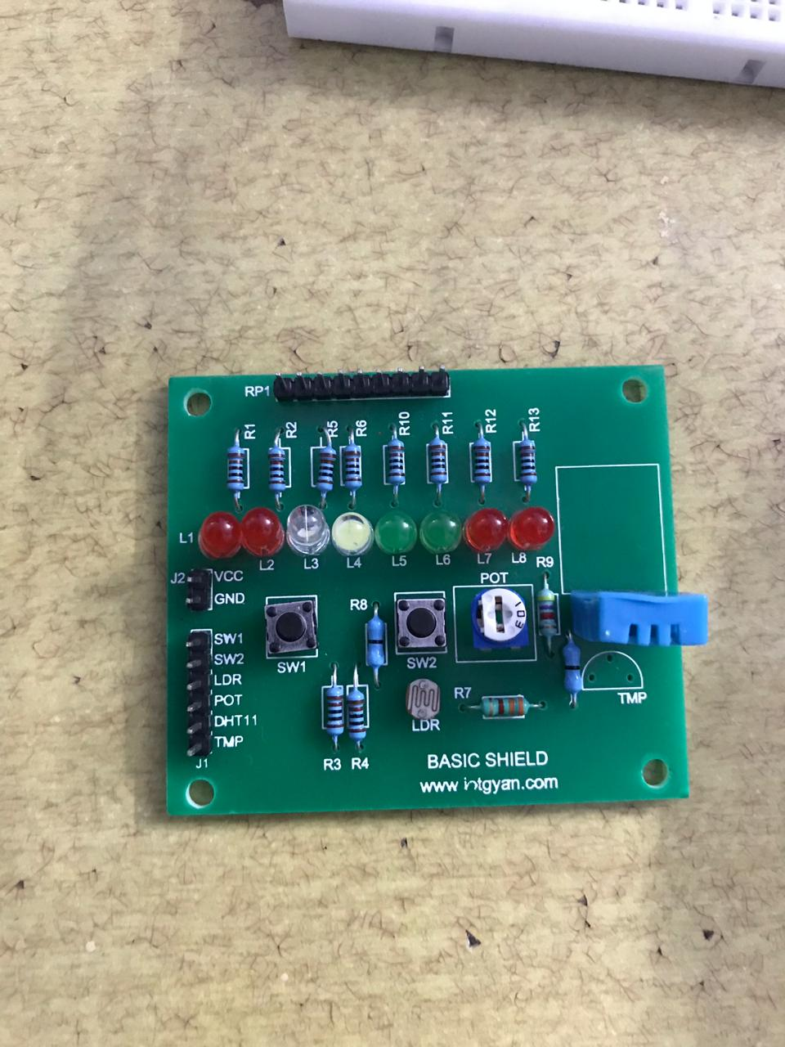
BASIC SHIELD

Slide 8
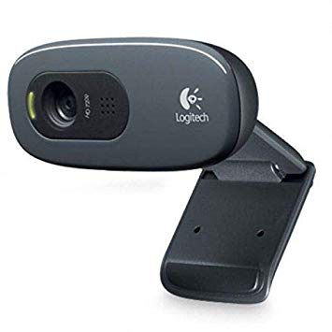
LOGITECH USB CAMERA

Slide 9
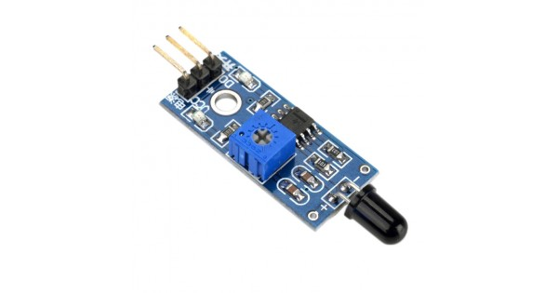
FLAME SENSOR (HL 01)
The flame sensor detects if there is any flame in the house and automatically triggers the buzzer to alert the people in the house.

Slide 10
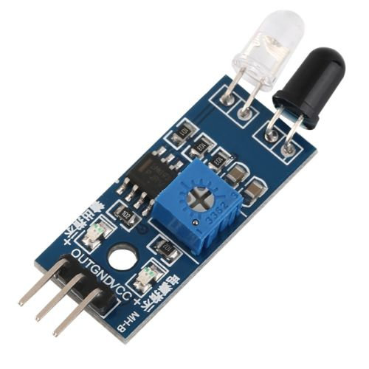
IR SENSOR
This sensor is used to detect motion.
When a motion is detected, it triggers a buzzer and an LED is switched on and the video stream will be activated which can be viewed on MIT app.

Slide 11
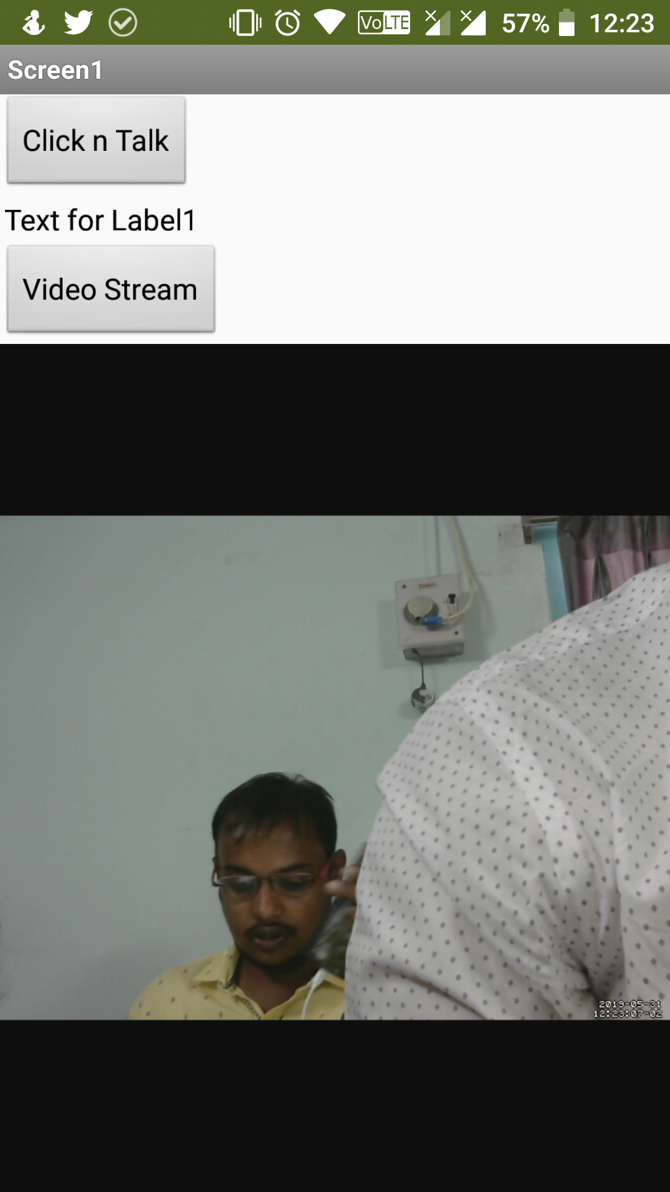
MIT APP INVENTOR
This is the UI of Smart Home security app which is done using MIT App Inventor.
The image on right side displays the live video feed of the security camera.
We can view the video stream by clicking on the Video Stream button

Slide 12
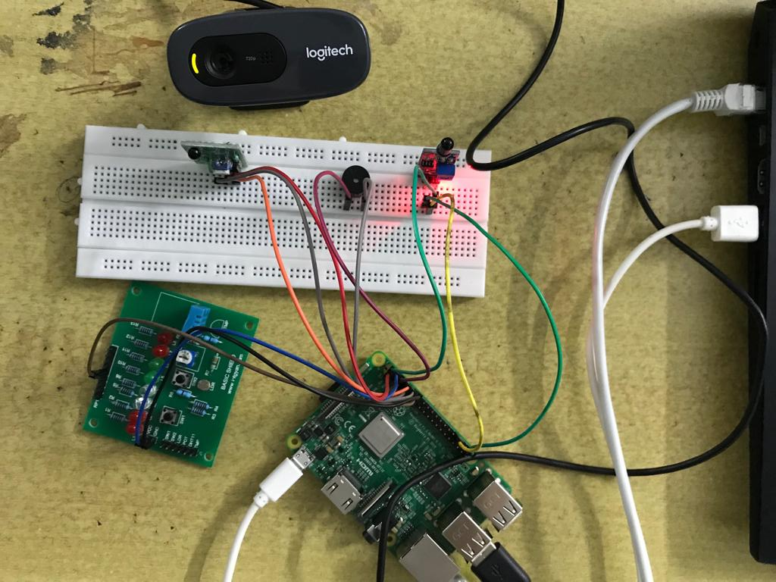
HANDS ON

Slide 13
CONCLUSION
With this project :
We can detect home intrusion
Fire detection

Slide 14

DEMO

